Slide 1
Acute Psychiatric Emergencies (APEx)
Session two:
Self harm risk assessment
De-escalation
Mental state examination
Notes:
Allocated time for Session two is 1hr 45 minutes split as follows:
Self harm risk assessment (30 minutes)
De-escalation (30 minutes)
Mental state examination (45 minutes)
The slide set will guide you through this session

Slide 2
Acute Psychiatric Emergencies (APEx)
Self harm risk assessment
Notes:
Allocated time: 30 minutes
Review the learning outcomes with the whole group
Ask the candidate to use handout in their pack during the exercise which will be in breakout rooms
The role of Michal will be played by an actor
Ask the co-ordinator to open the breakout rooms for 20 minutes
The instructors in the breakout room will facilitate the activity and lead the summary with 5 minutes available at the start and end of the breakout room session
At the end of the session the co-ordinator will close the breakout rooms and return the candidates and faculty to the main room

Slide 3
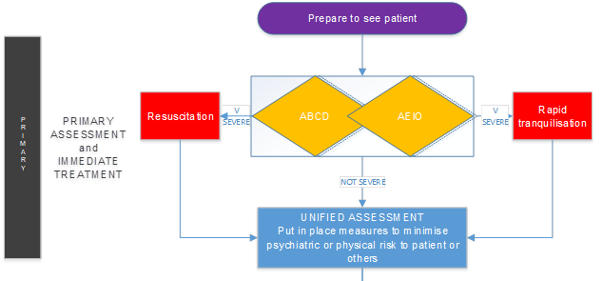
Learning outcomes
By the end of this session in small groups you will have:
performed a self-harm risk assessment, including an AEIO Unified Assessment and a full focused conversational psychosocial history

Slide 4
Michal
Let’s return to Michal’s case
Michal is a 42 year old Polish man who jumped 40 feet from scaffolding
Review the AEIO Unified Assessment you completed during the Overdose and self-harm lecture and then working in fours you will explore the focused conversational psychosocial history …

Slide 5
Acute Psychiatric Emergencies (APEx)
De-escalation
Notes:
Allocated time: 30 minutes
Whole group session
Project the case to lead a discussion about the techniques that might be used in de-escalation (see faculty handout on de-escalation to guide key points)

Slide 6
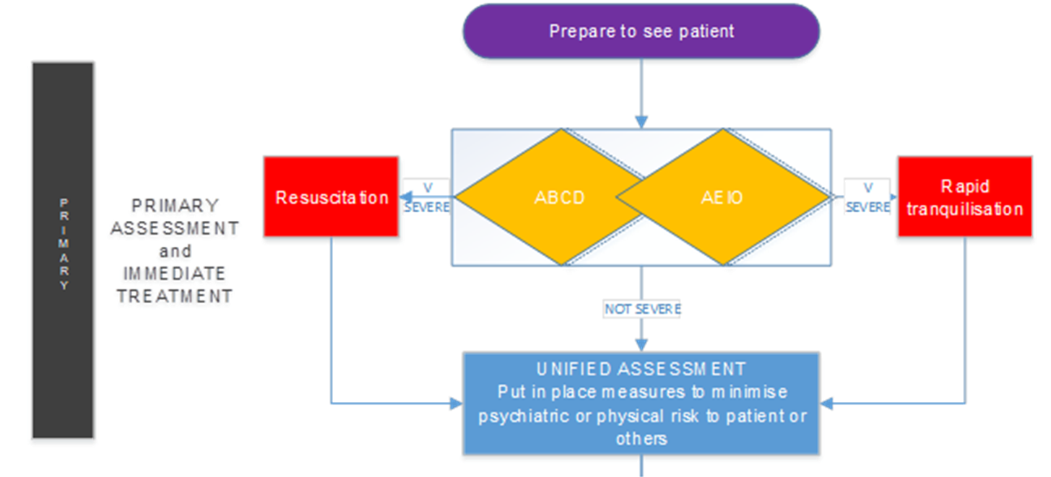
Learning outcomes
By the end of this session you will have:
recognised when de-escalation techniques can be employed
assessed the requirement for rapid tranquilisation
identified the risks associated with rapid tranquilisation

Slide 7
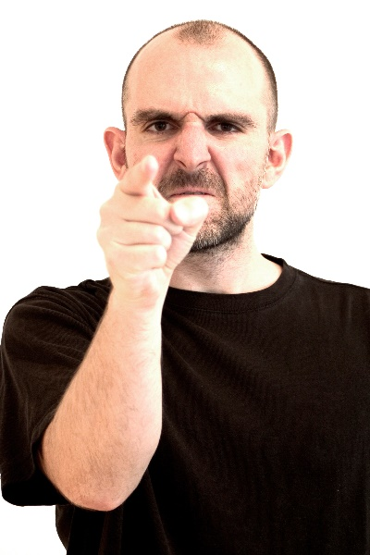
Declan
Declan has been brought into the department by police after a domestic incident. He has threatening to kill his wife because neighbours were telling him that she was poisoning him.
You ask Declan to sit down, but he is unable to remain seated and paces around the room. He wants to leave the department and go home to kill her now.

Slide 8
Summary
De-escalation is always a combination of psychological, environmental techniques +/- RT.
Aim for ECG, bloods, physical exam as early as possible if there is a chance the patient may later require RT.
Consider staff and patient safety at all times.
Offer oral and use low doses.
Aim is for the patient to be calm and able to converse rather than impaired conscious level.

Slide 9
Acute Psychiatric Emergencies (APEx)
Mental state examination
Notes:
Allocated time: 45 minutes
Review the learning outcomes with the whole group
Then ask the co-ordinator to open up the breakout rooms
This exercise is facilitated by instructors and an actor will play the role of the patient
Candidates have handouts of the proformas and SBAR and Maudsley structures in their packs
Instructors should leave the breakout room whilst the candidates prepare their handover
Instructors then return to the breakout room to take the handover
Instructors then close session two by asking if there are any questions and reminding candidates to mute their microphones, turn off their cameras and return promptly for session three after lunch

Slide 10
Learning outcomes
By the end of this session in small groups you will have:
performed a mental state examination
communicated your findings to a colleague using a structured approach

Slide 11
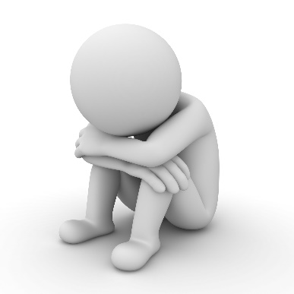
Patient
The patient has been brought to A&E by the ambulance having had a panic attack in the town square.
In breakout rooms – complete the patient’s mental state examination and when asked by instructors prepare and deliver a structured handover using SBAR and Maudsley

