Slide 1
Acute Psychiatric Emergencies (APEx)
Welcome and aims
Notes:
Allocated time for Welcome and Session one is 1hr 45 minutes split as follows:
Welcome and aims (10 minutes)
Structured approach (40 minutes)
Security safety discussion (30 minutes)
Overdose and self-harm (25 minutes)

Slide 2
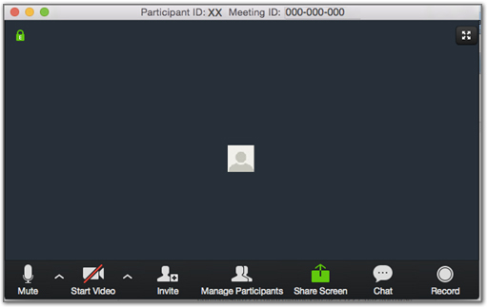
Zoom Etiquette
Notes:
Go through mute/unmute and up arrow by side of microphone which will tell you where you audio source is.
Video on/off, probably want this off unless interacting in group sessions.
Please be aware of anything going on in the background – eg radios on, your phones etc.
Please use chat facility – can type in questions etc here. Encourage you to answer each other and we will just facilitate this as faculty.

Slide 3
Acute Psychiatric Emergencies (APEx) Aims
To provide the knowledge necessary for effective assessment and management of patients with acute mental health emergencies
To teach the practical, structured approach to the combined emergency medicine and liaison psychiatric assessment and management of patients with acute mental health emergencies
To continuously assess the acquisition of these

Slide 4
Acute Psychiatric Emergencies (APEx) Content
Theory | Manual and e-modules
Practical | Remotely enhanced day workshops
 | Face-to-face simulations
Assessment | Pre-course: e-modules
 | In course: continuous
Notes:
Candidates will be assessed during workshops and simulations on their knowledge/skills as well as their performance working either within a team, or as a team leader. They will also be assessed for their potential as future instructors, based on their enthusiasm, support of colleagues, team-working, communication skills and credibility.

Slide 5
Acute Psychiatric Emergencies (APEx) Your role
You should:
have read the book!
completed the pre-course e-modules
attend all sessions and promptly
complete your reflective log during the course
support your faculty and fellow candidates
enjoy yourself!
Notes:
Candidates should be informed that they will be assessed in simulations on both technical and non-technical skills, but also when observing and debriefing.
Reflective log:
Candidates can access electronic copy on-line
Capture reflections during the course that you can then utilise in the clinical environment
Time at end of day 2 to share your experiences and implementation of the APEx approaches in practice

Slide 6
Simulations
You will play your own role
Actors will play the role of patients
Each person will take a turn at leading - If you would not normally complete a physical assessment as part of your job role you can invite a colleague who is competent at physical assessment to assist you as a member of your team – they will not take over the lead role in the simulation.
The debrief will cover technical and non-technical areas

Slide 7
Acute Psychiatric Emergencies (APEx)
Session one:
Structured approach to APEx
Securing safety
Overdose and self-harm

Slide 8
Acute Psychiatric Emergencies (APEx)
Structured approach to APEx
Notes:
Allocated time: 40 minutes
The slide set will guide you through this session
Ensure that you test the videos and that you have the Zoom set correctly for sharing videos (see Educational considerations document)
[TO ADD LSQs]

Slide 9
Learning outcomes
By the end of this session you will have consolidated your understanding of:
The structured approach to preparing for an assessment of a patient with possible mental health problems
The structured approach to managing psychiatric emergencies
Notes:
Will cover both
Should already be familiar from book
Will be reviewing regularly over 2 day course

Slide 10
Focus on the APEx course
Physical elements of the assessment and management will be mentioned for completeness during the course
The focus of the teaching will be on the combined assessment and management of the patient and the psychiatry elements of the structured approach
In simulations, this will also be the case – you will see a demonstration shortly
Notes:
As part of this presentation we will look at two demo videos to allow us to practice using ABCD AEIOU together as a team

Slide 11
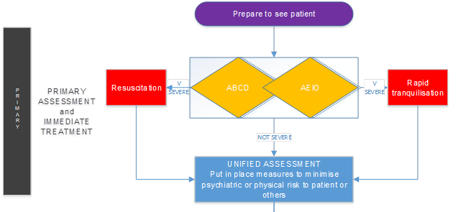
Notes:
1:4 in manual shows whole algorithm
This is FIRST part of algorithm - consider similarities to APLS, ALS (or ATLS) algorithms
First use of them can be daunting - but become integral to normal practice - useful in teaching and as reminders for those already competent/expert
When preparing to see acutely disturbed patient consider background info and setting (usually ED)
ABCD as used to using in physical health (consider organic causes) deal with significant findings systematically as they arise as with ALS – if severe move to RESUS
Then AEIO = Agitation Environment Intent Objects (Primary psych assessment) if any findings severe, or high risk to self/others – consider RAPID TRANQ
If neither yellow diamond = high risk then move onto unified assessment

Slide 12
PRIMARY ASSESSMENT and IMMEDIATE TREATMENT
The Structured Approach

Slide 13
ABCD
A
Airway patency and security
B
Breathing adequacy
C
Circulatory challenge
Disability derangement
D
Notes:
Ask member of audience (confident ED team member) to describe potential ABCD problems leading to agitation and examples of patients that would fulfil severe criteria to move to RESUS
e.g. Airway = affected by reduced GCS after overdose - use of illicit drugs and/or alcohol
Breathing = rapid due to DKA or hypoxia due to infection - both can make patients appear acutely agitated
Circulation = tachycardia or hypotension due to hypovolaemic shock in fall from height or DSH
Disability = patient had seizure due to OD, post ictal, drowsy due to head injury, meningitis/encephalitis can cause acute agitation, or even space occupying lesions

Slide 14
Resuscitation
Insecure airway
Inadequate breathing
Challenged circulation
Reduced conscious level
Notes:
Reasons patient may need to urgently move to resus - regardless of mental state or psychiatric condition

Slide 15
RIRA
A
Agitation / arousal
E
Environment in which the patient is being cared for
I
0
Objects which the patient has in their possession, which may be used for self-harm or harm to others
Intent of individual
Notes:
RIRA = Rapid Informed Risk Assessment - mental health equivalent of ABCD = AEIO
Ask member of audience (confident psych team member) to describe potential AEIO problems leading to high risk and examples of patients that would fulfil severe criteria to move to RAPID TRANQ

Slide 16
Agitation / Arousal
Sits still
Easily aroused, paces and settles
Pacing up and down, unable to settle, overt aggression

Slide 17
Environment
Alarm
Doors
Exits
Ligature points
Location
Equipment
Notes:
Often in ED we are not as good at thinking about these things - in psych wards areas might be alarmed already etc
Good Algorithm to remind you of things to check before you say ‘HELLO’ (sung Adelle Style ☺)

Slide 18
Intent
Current thoughts of self-harm
Current thoughts of harming others
Desire to leave
Psychotic experiences

Slide 19
Intent
None
Some thoughts but resistable
Thoughts difficult to resist, command hallucinations, actively trying to leave

Slide 20
Objects
Objects with potential for harm to self or others

Slide 21
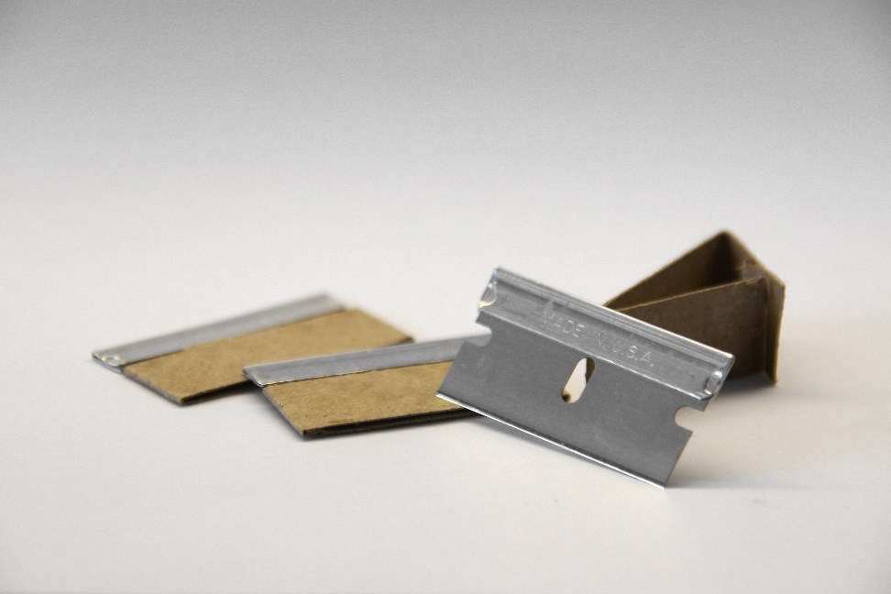
Objects
Make a list

Slide 22
Objects
No objects of danger
Denial but obstructs search
Admission and refusal to give up

Slide 23
Unified assessment
U
A
B
C
D
A
E
I
O
Notes:
Add it all together to make a unified assessment of both physical and mental health = U
This helps you to make a judgement as to the measures that need to be put in place to keep this patient safe in your department
Consider WHERE patient should be - and the degree of observation required including staff numbers
Refer to red yellow green TABLE on 2:10 for guidance regards staff numbers for safe containment
(NB RED = consider RAPID TRANQ, table is by consensus agreement rather than strict evidence base and your own clinical judgment can always override written guidance)

Slide 24
Immediate Risk Assessment
Risk of harm to self
Risk of harm to others
Flight risk

Slide 25
Immediate Treatment
Rapid tranquilisation

Slide 26
Immediate Treatment
Containment requirement
Physical environment
Staff numbers

Slide 27
Case example
Notes:
Mention that will already have seen this video, so this is a reminder to allow them to then complete the exercise
Full room watches video - send each group of 4 into non-facilitated breakout rooms for 7 minutes (number ***) using handout provided in their packs. This will help them to help them describe what they have seen - suggest that a psychiatry candidate leads on ABCD, an ED candidate leads on AEIO and then the group combines the ABCD-AEIOU
Ask the co-ordinator to open the breakout rooms
After 7 minutes co-ordinator will bring them back to main session
Lead a reflection on the exercise with the whole group – any comments/questions?

Slide 28
Case example
Notes:
NB. The co-ordinator will make these different groupings
Mention that will also already have seen this video, so this is a reminder to allow them to then complete the exercise
Full room watches video - send each group of 4 into non-facilitated breakout rooms for 5 minutes using handout which will be provided in their packs (number ***) to help them describe what they have seen suggest that different candidates lead on ABCD, AEIO and then the group joins together to combine the ABCD-AEIOU
Ask the co-ordinator to open the breakout rooms
After 5 minutes the co-ordinator will bring them back to main session
Lead a reflection on the exercise with the whole group – any comments/questions?

Slide 29
SECONDARY ASSESSMENT AND EMERGENCY MANAGEMENT
Notes:
Now onto second stage of full algorithm
Left hand side remains related to PHYSICAL HEALTH – ABCD moves on to focused physical history and secondary more detailed physical examination
In ATLS this would be the ‘secondary survey’ - might be useful to think of this for ED doctors/nurses as a comparison
Left hand side remains related to PHYSICAL HEALTH – ABCD moves on to focused physical history and secondary more detailed physical examination
In ATLS this would be the ‘secondary survey’ - might be useful to think of this for ED doctors/nurses as a comparison
Right hand side related to MENTAL HEALTH - AEIO moves on to focused psychosocial history and MSE
Either side of the algorithm might highlight further physical treatment needs that were perhaps not initially apparent in ABCD, or further psych management needs ( ie. MHA)

Slide 30
Secondary assessment
Engage in dialogue as this contributes to de-escalation
Always consider whether there is an alternative physical cause for the presentation, especially if first presentation

Slide 31
Focused physical history
Problem
History of presenting problem
Relevant medical history
Allergies
Systems review
Essential family and social history
Drugs
Always consider whether there is an alternative physical cause for the presentation, especially if first presentation
Notes:
This can be useful for those team members who are not routinely working in the ED and treating patients with physical health problems

Slide 32
Focussed physical examination
As complete an examination as possible
Always consider whether there is an alternative physical cause for the presentation, especially if first presentation
Notes:
May be cardiovascular respiratory gastrointestinal neurological

Slide 33
Focussed physical investigation
As indicated by physical history and examination
Always consider whether there is an alternative physical cause for the presentation, especially if first presentation
Notes:
- may lead to blood tests ECG CXR ABGs CT head or other xrays in ED
If you usually work in psych setting you might not feel confident about these aspects of physical examination or investigation. – please do feel free to ask advice of your other team members during the workshops and simulations (as you might do in ‘real life’)

Slide 34
Focussed psychosocial history
Problem
History of presenting psychiatric problem
Eg SLIPA
Relevant psychiatric history and forensic history
Allergies
Substance (mis)use and Self-harm
Emotional trauma
Drugs
Notes:
PHRASED can be used again - if already completed physical history PHRASED then don’t need to repeat the P A D sections as already done
SLIPA = suicidality lethality Intent (ongoing) Productive / Adverse factors

Slide 35
Focussed psychosocial history
Problem
History of presenting psychiatric problem
Eg SLIPA
Relevant psychiatric history and forensic history
Allergies
Substance (mis)use and Self-harm
Emotional trauma
Drugs
Notes:
But then you get HRSE - sounds too much like HEARSE !! Try to avoid them for our patients !!!

Slide 36
Focused psychosocial history
Aim to identify or exclude substance misuse as a contributory factor
Explore issues of risk further
Explore non-organic symptoms that support referral to an acute psychiatric service
Always consider whether there is an alternative physical cause for the presentation, especially if first presentation

Slide 37
Mental state examination
Appearance and behaviour
Speech
Mood
Thoughts:
Disorders of thought form
Disorders of thought content
Perceptions
Cognition
Notes:
Further details of this is chapter 3 and a workshop too
‘All Brides Should Make Tea Cakes In Summer’ – reminder from university days
Appearance Behaviour Speech Mood Thoughts Cognition Insight Summarise

Slide 38
EMERGENCY TREATMENT
Secondary assessment

Slide 39
EMERGENCY TREATMENT
Notes:
Some patients need further physical AND mental health input during admission
If multiple physical injuries - do not forget to assess mental health - example of trauma resus - followed by jumping from hospital several days later as mental health assessment not adequately completed.

Slide 40
Acute Psychiatric Emergencies (APEx)
Securing safety
Notes:
Allocated time: 30 minutes
Review the learning outcomes with the whole group and then ask the co-ordinator to open the breakout rooms
In facilitated breakout rooms in groups of four:
Candidates have been asked to bring a case
Discuss cases - facilitator to ensure that all elements are covered during the case discussions
Questions and review

Slide 41
Learning outcomes
By the end of this session you will have consolidated your understanding of the approach to securing safety for:
Staff
Patients
Others in the department
The wider community
Notes:
One of the most important things to consider when preparing to see an acutely disturbed patient is safety. Safety for yourself, others members of staff, the patient and the wider public or other patients.

Slide 42
Acute Psychiatric Emergencies (APEx)
Overdose and self harm
Notes:
Allocated time: 25 minutes
Whole group with unfacilitated breakout exercise for 10 minutes

Slide 43
Learning outcomes
By the end of this session you will have consolidated your understanding of:
How to apply the structured approach to patients who have self harmed
How mental health and physical health assessments for self harm can be integrated

Slide 44
Michal
In groups of three – read more about Michal’s case and complete the primary assessment proforma
Notes:
The groups will be organised by the co-ordinator
Candidates will have a copy of the case and the proforma in their pack
When you have set the exercise, ask the co-ordinator to open the breakout rooms for 10 minutes
This exercise is unfacilitated so the faculty will all remain in the main room

Slide 45
Notes:
The co-ordinator will bring the candidates back from the breakout rooms after 10 minutes
Lead a discussion with each group using the proforma as a guide

Slide 46
Acute Psychiatric Emergencies (APEx)
Session one:
Structured approach to APEx
Securing safety
Overdose and self-harm

Slide 47
COMFORT BREAK
Stay logged on but mute and turn off camera
Notes:
Remind candidates to return on time for session two

